Slide 1
PROTOTYPE MODEL
CHAPTER ONE-SDLC
Notes:
NOTE: Want a different image on this slide? Select the picture and delete it. Now click the Pictures icon in the placeholder to insert your own image.

Slide 2

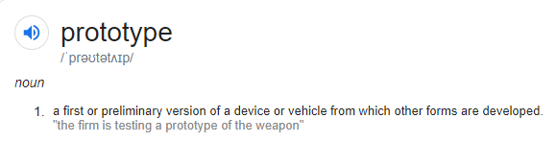

Slide 3
PROTOTYPING
Prototyping is the activity of creating incomplete versions of the product being developed.

Slide 4
PROTOTYPE MODEL
It is one of the forms of the Software Development Cycle (SDLC) models, which is based on the quick initial development of the prototypes based on the currently available or limited requirements
In this model, a prototype of the product is first developed, tested and refined as per customer feedback repeatedly till a final acceptable prototype is achieved.

Slide 5
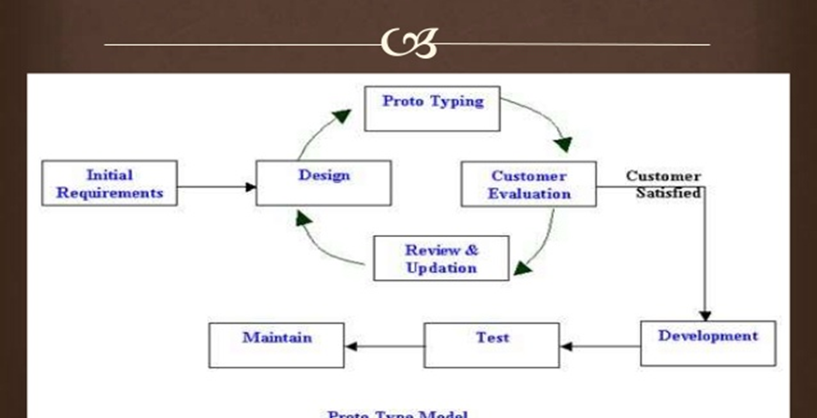

Slide 6
Basic Requirement Identification
Developing the initial Prototype
Review of the Prototype
Revise and Enhance the Prototype

Slide 7

WHEN?
When the desired system needs to have a lot of interaction with the end users
System which needs high amount of interaction with end users like online systems, web interfaces are best suited for Prototype model.

Slide 8
TYPES OF PROTOTYPING
Rapid Prototyping
Evolutionary Prototyping
Incremental Prototyping
Xtreme Prototyping

Slide 9

Rapid Prototyping​
based on the preliminary requirement.
uses very little efforts with minimum requirement analysis to build a prototype.
Once the actual requirements are understood, the prototype is discarded, and the actual system is developed.
Evolutionary Prototyping​
prototyping is based on building actual functional prototypes with minimal functionality in the beginning.
the prototype developed initially is incrementally refined on the basis of customer feedback till it finally gets accepted.

Slide 10
Incremental Prototyping
building multiple functional prototypes of the various sub-systems and then integrating all the available prototypes to form a complete system.
Xtreme Prototyping
services are implemented and integrated into the final prototype
mostly used for web development.
Basic prototype with all the existing page is present in the HTML format.
simulate data process using a prototype services layer.

Slide 11
PROS
Active involvement of user in development.
Helps to reduce the risk of failure as prototyping is also considered as a risk reduction activity.
Customer satisfaction.
Reduces time and cost as the defects can be detected much earlier.
Quicker user feedback is available leading to better solutions.
Missing functionality can be identified easily.
Confusing or difficult functions can be identified.

Slide 12
CONS
Prototyping is a slow and time taking process.
Prototyping may encourage excessive change requests which could leads to confusion in the prototypes and actual systems.
The cost of developing a prototype is a total waste as the prototype is ultimately thrown away.
Sometimes customers may not be willing to participate in the iteration cycle for the longer time duration.
Practically, this methodology may increase the complexity of the system as scope of the system may expand beyond original plans.
Developers may try to reuse the existing prototypes to build the actual system, even when it is not technically feasible.

Slide 13
SPIRAL MODEL

Slide 14
SPIRAL MODEL
The spiral model os a risk-driven software development process model. Based on the unique risk patterns of a given project, the spiral model guides a team to adopt elements of one or more process models such as iterative, waterfall, or evolutionary prototyping.
The development team in Spiral-SDLC model starts with a small set of requirement and goes through each development phase for those set of requirements.

Slide 15
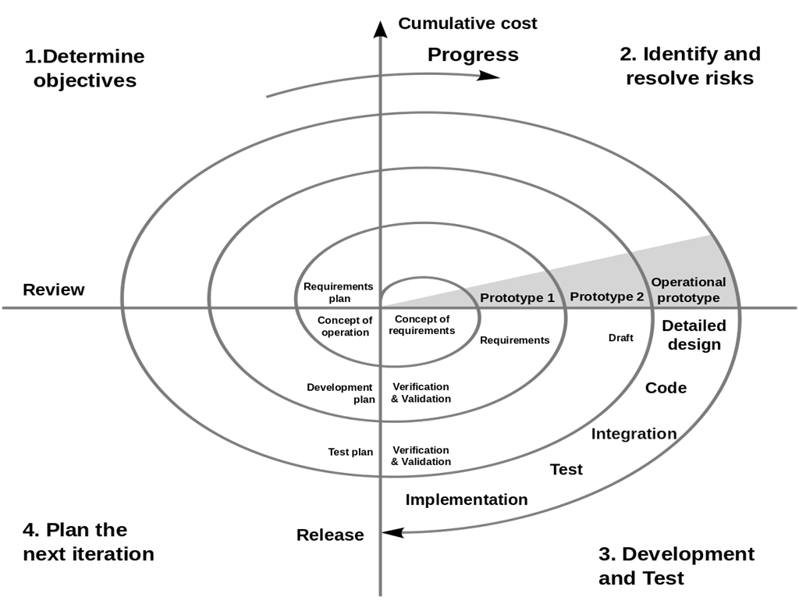

Slide 16
APPLICATION
When project is large
When releases are required to be frequent
When creation of a prototype is applicable
When risk and costs evaluation is important
For medium to high-risk projects
When requirements are unclear and complex
When changes may require at any time
When long term project commitment is not feasible due to changes in economic priorities

Slide 17
PROS
Additional functionality or changes can be done at a later stage.
Cost estimation becomes easy as the prototype building is done in small fragments.
Continuous or repeated development helps in risk management.
Development is fast and features are added in a systematic way.
There is always a space for customer feedback.

Slide 18
CONS
Risk of not meeting the schedule or budget.
It works best for large projects only also demands risk assessment expertise.
For its smooth operation spiral model protocol needs to be followed strictly.
Documentation is more as it has intermediate phases.
It is not advisable for smaller project, it might cost them a lot.

